Slide 1
Azure Brushup

Slide 2





















Slide 3
Azure Entra ID
Identity and Access Management Service
User and Group Management
Licenses
App Registrations
Self Service Password Reset

Slide 4
User 1
User 2
User 3
User 4
User 5
Group 1
Group 2
Group 3
Group 4
Group 5
Subscription 1
RG 1
RG 2
RG 3
Subscription 2
RG 4
RG 5
Management Group
Subscription 1
RG 1
RG 2
Subscription 2
RG 4
RG 3
RG 5

Slide 5
Azure Virtual Machines
IaaS Cloud Services
Planning Checklist
Start with the Network
Name the VM
Decide the location for VM
Determine the size of the VM
Storage for the VM
OS

Slide 6
High Availability
Availability Sets – Rack Level
Availability Zones – Datacenter Level
Virtual Machine Scale Set – Auto Scaling

Slide 7
Storage
Scalable object store – Blob Storage
File system service for the cloud – File Share
Messaging Store – Queue Storage
NoSQL store - Tables

Slide 8


Redundancy
LRS
ZRS
GRS
RA-GRS
GZRS
RA-GZRS

Slide 9
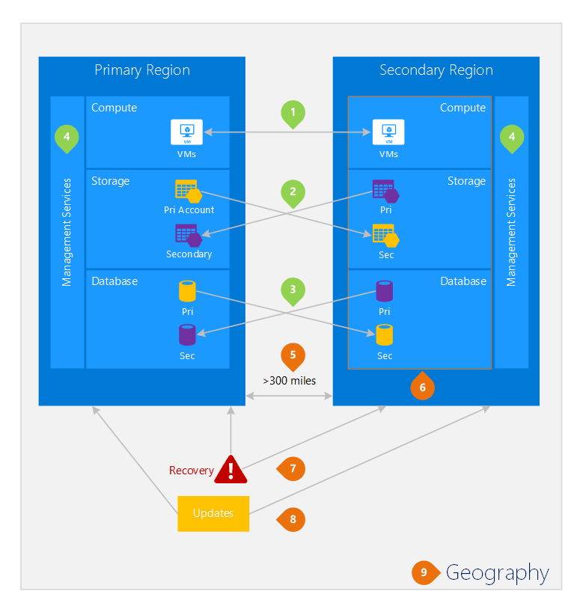

Slide 10






Virtual Networks
Representation of your own network in the cloud
CIDR – Classless Interdomain Routing
Address Space: 10.0.0.0/16
Subnet: VNet segmented into one or more subnets
Service Endpoint

Slide 11
Network Security Group
A service to limit the network traffic to resources in a virtual network.
Inbound Rules
Outbound Rules

Slide 12







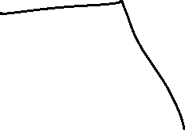










Load Balancer
High availability and network performance to your applications
OSI Layer 4

Slide 13
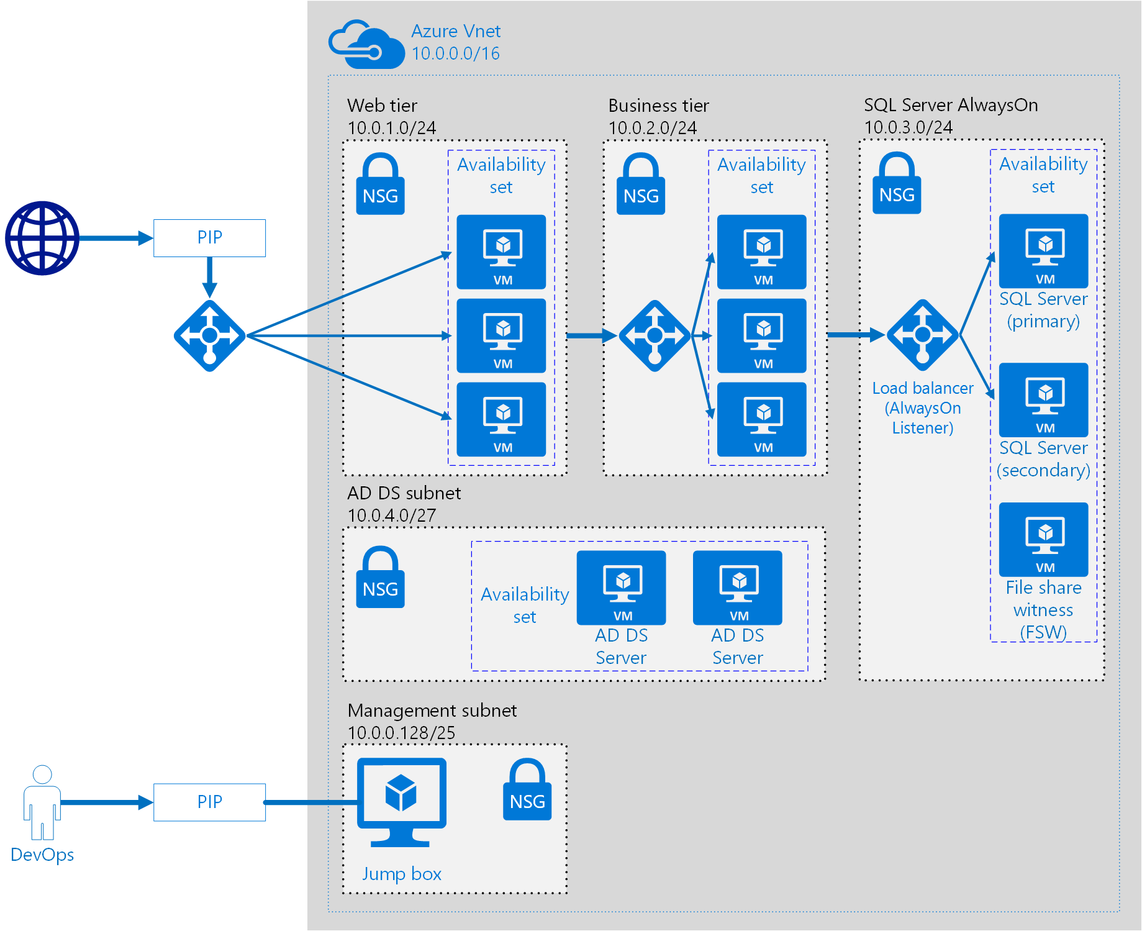















Slide 14
Azure App Service
PaaS from Microsoft to deploy, design and scale web apps
App Service
App Service Plan

Slide 15


App Service
Container Instance
AKS

